Slide 1

Shortest Paths
Analyzing three variations of Dijkstra’s algorithm for solving two different shortest paths problems.
Kevin Lin, with thanks to many others.
Notes:
Ask questions anonymously on Piazza. Look for the pinned Lecture Questions thread.

Slide 2
Feedback from the Reading Quiz
Dijkstra’s algorithm walkthrough…
A graph where every vertex is connected to every other vertex is called a complete graph.
Reflections on Monday’s course assessment.

Slide 3
BreadthFirstPaths
private boolean[] marked;
private int[] edgeTo;
private void bfs(Graph G, int s) {
Queue<Integer> fringe = ...;
fringe.add(s);
marked[s] = true;
while (!fringe.isEmpty()) {
int v = fringe.remove();
for (int w : G.adj(v)) {
if (!marked[w]) {
fringe.add(w);
marked[w] = true;
edgeTo[w] = v;
}
}
}
}
Demo
Instance variables store algorithm data.
marked[v] is true iff v connected to s. edgeTo[v] is vertex visited to get to v.
BreadthFirstPaths constructor computes the result of the algorithm with the bfs iterative method.
Cost model given undirected graph?
Each vertex is visited at most once. Each edge is checked at most twice.

Slide 4
Single-Source Shortest Paths
Goal: Find the shortest paths from source vertex s to every other vertex.
Identify: Solution will always be a tree.
3
v | distTo[] | edgeTo[]
0 | 0.0 | -
1 | 2.0 | 0 -> 1
2 | 1.0 | 0 -> 2
3 | 11.0 | 6 -> 3
4 | 5.0 | 1 -> 4
5 | 9.0 | 4 -> 5
6 | 10.0 | 4 -> 6
11
1
1
2
2
3
6
5
4
5
s
0
1
1
4
1
2
15
5

Slide 5
Shortest Paths Tree
Q
If G is a connected edge-weighted graph with V vertices and E edges, how many edges are in the Shortest Paths Tree (SPT) of G? Assume every vertex is reachable.
3
v | distTo[] | edgeTo[]
0 | 0.0 | -
1 | 2.0 | 0 -> 1
2 | 1.0 | 0 -> 2
3 | 11.0 | 6 -> 3
4 | 5.0 | 1 -> 4
5 | 9.0 | 4 -> 5
6 | 10.0 | 4 -> 6
1
6
s
4
0
2
5

Slide 6
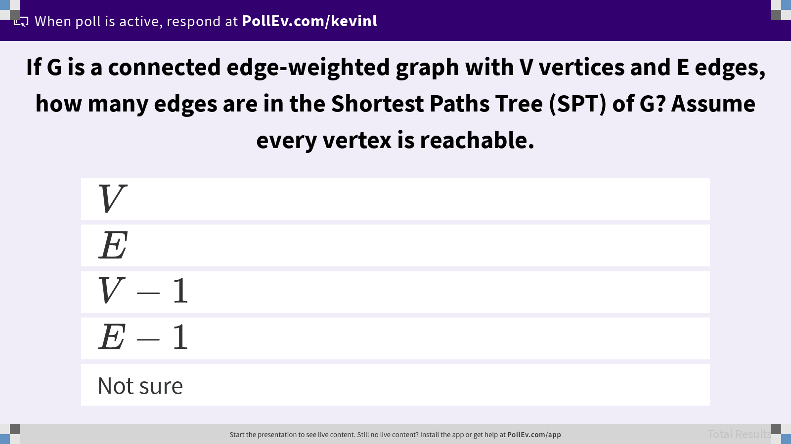
If G is a connected edge-weighted graph with V vertices and E edges, how many edges are in the Shortest Paths Tree (SPT) of G? Assume every vertex is reachable.

Slide 7
Finding a Shortest Paths Tree
Q
What is the shortest paths tree for the graph below starting from the source vertex A?
B
5
2
s
A
2
1
D
1
5
C

Slide 8
Finding a Shortest Paths Tree
A
What is the shortest paths tree for the graph below starting from the source vertex A?
Hypothesis: BFS queue considers A-B and A-C (marking immediate neighbors) first.
Identify: Explore A-C-B before A-B.
2
B
5
2
0
4
s
A
2
1
D
1
1
5
C

Slide 9
Algorithm for Finding a Shortest Paths Tree
Identify: Explore A-C-B before A-B.
Plan: Visit vertices in order of distance from source, not necessarily immediate neighbors. Maintain a priority queue ordered on the shortest available paths.
2
B
5
2
0
4
s
A
2
1
D
1
1
5
C

Slide 10
Dijkstra’s Algorithm
Demo
Insert all vertices into fringe PQ, storing vertices in order of distance from source.
While fringe is not empty: Remove (closest) vertex v and relax all edges pointing from v.
3
11
1
1
2
Edge Relaxation (v, w).
For each edge (v, w), add edge to the SPT only if the edge is closer than our best-so-far.
2
3
6
5
4
5
s
0
1
1
4
1
2
15
5

Slide 11
Dijkstra’s Pseudocode
PQ.add(s, 0)
For all other vertices v, PQ.add(v, infinity)
While PQ is not empty:
p = PQ.removeSmallest() Relax all edges from p
Relaxing an edge (v, w) with weight:
If distTo[w] > distTo[v] + weight:
distTo[w] = distTo[v] + weight edgeTo[w] = v PQ.changePriority(w, distTo[w])
Invariants
edgeTo[v]: best known predecessor of v.
distTo[v]: best known distance of s to v.
PQ maintains vertices based on distTo.
Important properties
Always visits vertices in order of total distance from source. Relaxation always fails on edges to visited (white) vertices.

Slide 12
Dijkstra’s Runtime Analysis
PQ.add(s, 0)
For all other vertices v, PQ.add(v, infinity)
While PQ is not empty:
p = PQ.removeSmallest() Relax all edges from p
Relaxing an edge (v, w) with weight:
If distTo[w] > distTo[v] + weight:
distTo[w] = distTo[v] + weight edgeTo[w] = v PQ.changePriority(w, distTo[w])
ArrayHeapMinPQ implementation.
V adds, each O(log V) time.
V removals, each O(log V) time.
E changePriority, each O(log V) time.
Overall: O(V log V + V log V + E log V).
Simple: O(V log V + E log V).
Assuming E > V, this is just O(E log V) for connected graphs.

Slide 13
Dijkstra’s Algorithm Correctness
Q
Dijkstra’s algorithm. Visit vertices in order of distance from source.
On visit, relax every edge from the visited vertex.
Dijkstra’s can fail if the graph has negative weight edges. Give an example graph.

Slide 14
Dijkstra’s Algorithm Correctness
A
Dijkstra’s algorithm. Visit vertices in order of distance from source.
On visit, relax every edge from the visited vertex.
Dijkstra’s can fail if the graph has negative weight edges. Give an example graph.
Hide the real shortest path behind a later-explored path.
9
9
34
1
1
33
-99

Slide 15
Dijkstra’s Algorithm Correctness
A
Dijkstra’s algorithm. Visit vertices in order of distance from source.
On visit, relax every edge from the visited vertex.
Dijkstra’s can fail if the graph has negative weight edges. Give an example graph.
Hide the real shortest path behind a later-explored path.
9
9
34
1
-90
-99
Violates distTo invariant!
33

Slide 16
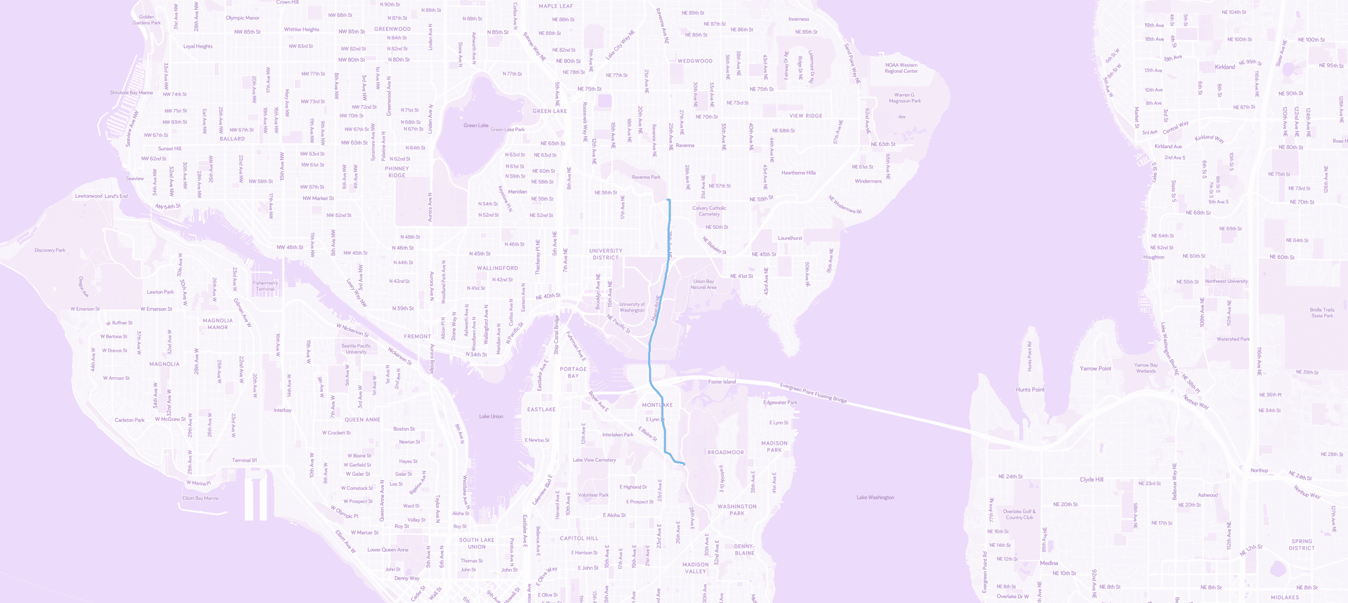
Single-Pair Shortest Path Problem
© Mapbox; © OpenStreetMap; Improve this map.

Slide 17
Single-Pair Shortest Path: Dijkstra’s Algorithm
© Mapbox; © OpenStreetMap; Improve this map.

Slide 18
Single-Pair Shortest Path: A* Search
© Mapbox; © OpenStreetMap; Improve this map.

Slide 19
A* Search Algorithm
Demo
Dijkstra’s algorithm with one modification.
Dijkstra’s algorithm: Priority is defined by distTo[v] only.
A* search: Priority is defined by distTo[v] + h(v, goal).
Where h(v, goal) is a heuristic: an estimate of the distance from v to the goal.
distTo[v]
h(v, goal)

Slide 20
Computing a Heuristic
Where h(v, goal) is a heuristic: an estimate of the distance from v to the goal.
For maps, we can use Euclidean distance (right triangle hypotenuse length).
h(v, goal)

Slide 21
Computing a Heuristic
Q
Where h(v, goal) is a heuristic: an estimate of the distance from v to the goal.
For maps, we can use Euclidean distance (right triangle hypotenuse length).
Will A* search return the correct shortest path if h(v, goal) = 10 for every v in the graph?
h(v, goal)

Slide 22
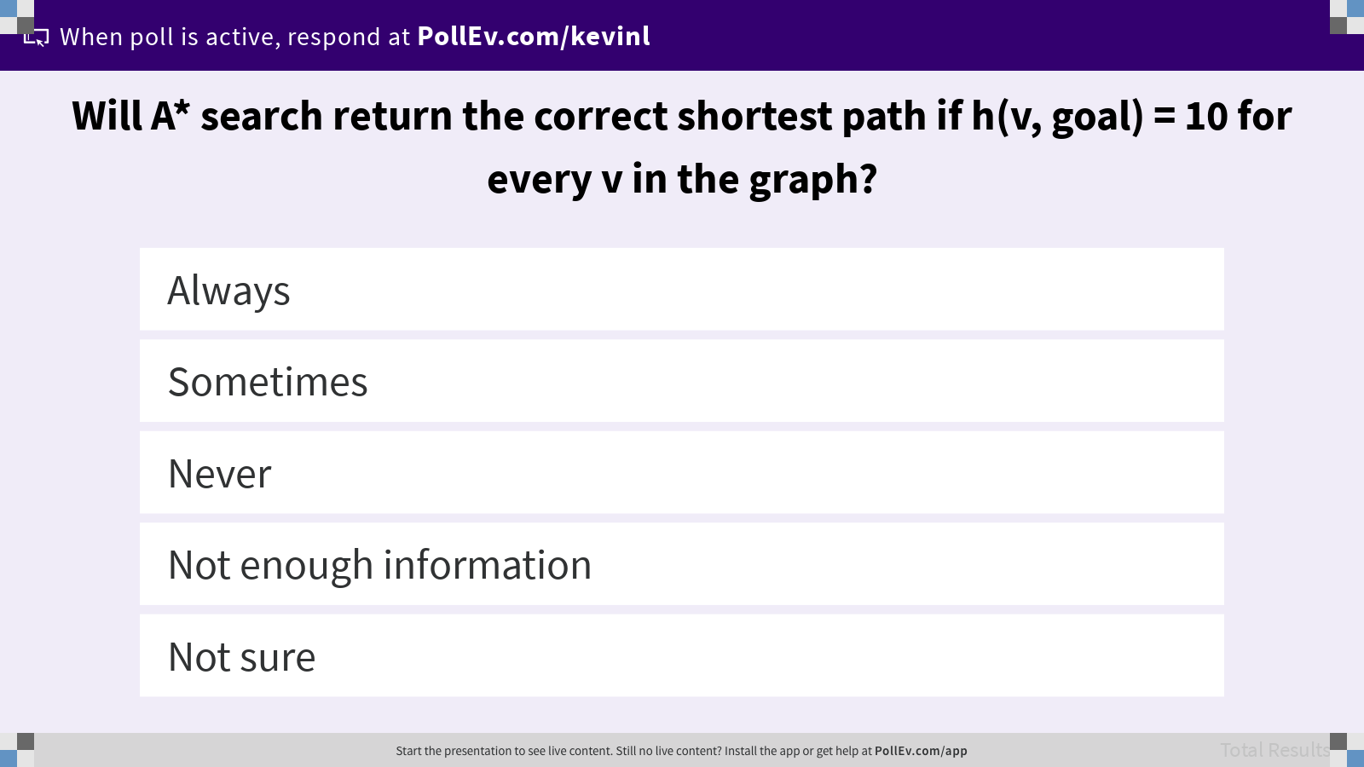
Will A* search return the correct shortest path if h(v, goal) = 10 for every v in the graph?

Slide 23
A bad heuristic: overestimating distance for a single point
h(Montlake Bridge, goal) = 100 miles
© Mapbox; © OpenStreetMap; Improve this map.

Slide 24
Single-Pair Shortest Path Algorithms
Demo
Dijkstra’s algorithm: Priority defined by distTo[v] only.
A* search: Priority defined by distTo[v] + h(v, goal). Correct if h is good.
Best-first (greedy): Priority defined by h(v, goal) only. Can be wrong even with good h!
For this course: Know that the choice of h matters. If h is bad, A* can be incorrect.
distTo[v]
h(v, goal)

Slide 25
Summary
Single-Source Shortest Paths: Shortest path from s to every reachable vertex.
Shortest path from s to every vertex is a shortest paths tree with V - 1 edges.
Compute the SPT on non-negative, weighted graphs using Dijkstra’s algorithm.
Single-Pair Shortest Path: Shortest path from s to a specific vertex v.
Dijkstra’s algorithm is inefficient because it solves for the SPT to every vertex.
Modify Dijkstra’s algorithm by adding a heuristic to capture the potential path length.
A* search algorithm can be much faster than Dijkstra’s depending on the heuristic.

Slide 26
Graph Problems and Their Solutions
Paths. Find a path from s to every reachable vertex. Depth-first search. O(V + E) runtime with adjacency list.
Unweighted Single-Source Shortest Paths. Find a shortest path from s to every reachable vertex. Breadth-first search. O(V + E) runtime with adjacency list.
Weighted Single-Source Shortest Paths. Find a shortest path from s to every reachable vertex. Dijkstra’s algorithm. O(E log V + V log V) runtime with adjacency list.
Weighted Single-Pair Shortest Paths. Find a shortest path from s to a single goal vertex. A* search. Dijkstra’s algorithm with h(v, goal) as priority. Runtime depends on heuristic.

Slide 27

What is your burning question from today’s lecture?

